Slide 1

Chapter 6 – Introduction to Public-Key Cryptography

Slide 2
Content of this Chapter
Symmetric Cryptography Revisited
Principles of Asymmetric Cryptography
Practical Aspects of Public-Key Cryptography
Important Public-Key Algorithms
Essential Number Theory for Public-Key Algorithms

Slide 3
Content of this Chapter
Symmetric Cryptography Revisited
Principles of Asymmetric Cryptography
Practical Aspects of Public-Key Cryptography
Important Public-Key Algorithms
Essential Number Theory for Public-Key Algorithms

Slide 4
Symmetric Cryptography revisited
Two properties of symmetric (secret-key) crypto-systems:
The same secret key K is used for encryption and decryption
Encryption and Decryption are very similar (or even identical) functions
Alice
Bob
x
e_{K}(x)
d_{K}(y)
x
y
K
K

Slide 5
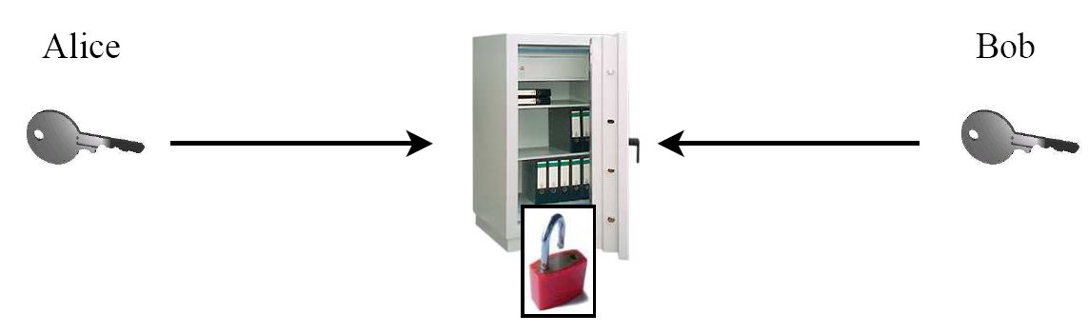
Symmetric Cryptography: Analogy
Safe with a strong lock, only Alice and Bob have a copy of the key
Alice encrypts → locks message in the safe with her key
Bob decrypts → uses his copy of the key to open the safe
K
K

Slide 6
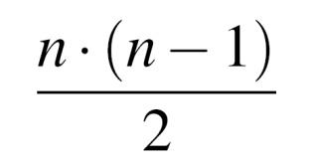
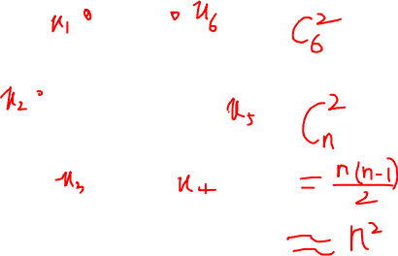
Symmetric Cryptography: Shortcomings
Symmetric algorithms, e.g., AES or 3DES, are very secure, fast & widespread but:
Key distribution problem: The secret key must be transported securely
Number of keys: In a network, each pair of users requires an individual key
→ n users in the network require keys, each user stores (n-1) keys
Alice or Bob can cheat each other, because they have identical keys. Example: Alice can claim that she never ordered a TV on-line from Bob (he could have fabricated her order). To prevent this: „non-repudiation“
Example:
6 users (nodes)
keys (edges)
Notes:
Analogy for symmetric-key algorithms: Symmetric-key schemes are analogous to a safe box with a strong lock.
Everyone with the key can deposit messages in it and retrieve messages.

Slide 7
Content of this Chapter
Symmetric Cryptography Revisited
Principles of Asymmetric Cryptography
Practical Aspects of Public-Key Cryptography
Important Public-Key Algorithms
Essential Number Theory for Public-Key Algorithms

Slide 8


Idea behind Asymmetric Cryptography
New Idea:
Use the “good old mailbox” principle:
Everyone can drop a letter
But: Only the owner has the
correct key to open the box
1976: first publication of such an algorithm by Whitfield Diffie and Martin Hellman,and also by Ralph Merkle.

Slide 9
Asymmetric (Public-Key) Cryptography
Principle: “Split up” the key
K
Public Key (K_{pub}) (Encrypt)
Secret Key (K_{pr}) (Decrypt)
→ During the key generation, a key pair K_{pub} and K_{pr} is computed

Slide 10
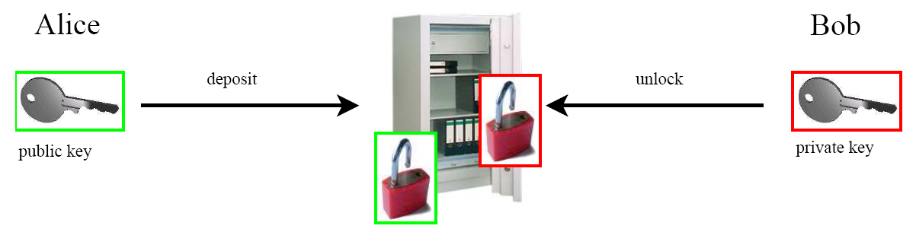
Asymmetric Cryptography: Analogy
Safe with public lock and private lock:
(K_{pub})
(K_{pr})
Alice deposits (encrypts) a message with the - not secret - public key K_{pub}
Only Bob has the - secret - private key K_{pr} to retrieve (decrypt) the message

Slide 11
Content of this Chapter
Symmetric Cryptography Revisited
Principles of Asymmetric Cryptography
Practical Aspects of Public-Key Cryptography
Important Public-Key Algorithms
Essential Number Theory for Public-Key Algorithms

Slide 12
Basic Protocol for Public-Key Encryption
Alice
Bob
K_{pubB}
(K_{pubB},K_{prB}) = K
x
y=e_{KpubB}(x)
y
x=d_{KprB}(y)
→ Key Distribution Problem solved *
*) at least for now; public keys need to be authenticated, cf.Chptr. 13 of Understanding Cryptogr.

Slide 13
Security Mechanisms of Public-Key Cryptography
Here are main mechanisms that can be realized with asymmetric cryptography:
Key Distribution (e.g., Diffie-Hellman key exchange, RSA) without a pre-shared secret (key)
Nonrepudiation an be realized with digital signature algorithms (e.g., RSA, DSA or ECDSA)
Integrity Digital signature algorithms can also ensure
Identification, using challenge-response protocols with digital signatures
Encryption (e.g., RSA / Elgamal)
Disadvantage: Computationally very intensive (1000 times slower than symmetric Algorithms!)
Notes:
It looks as though public-key schemes can provide all
functionality needed in modern security protocols such as
SSL/TLS. However, the major drawback in practice is that encryption of
data is extremely computationally demanding with public-key
algorithms. Many block and stream ciphers can encrypt 1000 times
faster in software than public-key algorithms. On the other hand,
symmetric algorithms are poor at providing digital signatures and key
establishment/transport functionality. Hence, most practical protocols
are hybrid protocols which incorporate both symmetric and public-key
algorithms.

Slide 14
Basic Key Transport Protocol 1/2
In practice: Hybrid systems, incorporating asymmetric and symmetric algorithms
Key exchange (for symmetric schemes) and digital signatures are performed with (slow) asymmetric algorithms
Encryption of data is done using (fast) symmetric ciphers, e.g., block ciphers or stream ciphers

Slide 15
Basic Key Transport Protocol 2/2
Example: Hybrid protocol with AES as the symmetric cipher
Alice
Bob
K_{pubB}
(K_{pubB},K_{prB}) = K
Choose random symmetric key K
Key Exchange
(asymmetric)
y₁ = e_{KpubB}(K)
y₁
K = d_{KprB}(y₁)
message x
Data Encryption
(symmetric)
y₂
y₂ = AES_{K} (x)
x = AES⁻¹_{K} (y₂)

Slide 16
Content of this Chapter
Symmetric Cryptography Revisited
Principles of Asymmetric Cryptography
Practical Aspects of Public-Key Cryptography
Important Public-Key Algorithms
Essential Number Theory for Public-Key Algorithms

Slide 17
How to build Public-Key Algorithms
Asymmetric schemes are based on a “one-way function” f():
Computing y = f(x) is computationally easy
Computing x = f⁻¹(y) is computationally infeasible
One way functions are based on mathematically hard problems. Three main families:
Factoring integers (RSA, ...): Given a composite integer n, find its prime factors (Multiply two primes: easy)
Discrete Logarithm (Diffie-Hellman, Elgamal, DSA, …): Given a, y and m, find x such that a^{x} = y mod m (Exponentiation a^{x} : easy)
Elliptic Curves (EC) (ECDH, ECDSA): Generalization of discrete logarithm
Note: The problems are considered mathematically hard, but no proof exists (so far).
Notes:
In addition, there are many other public-key schemes, such as NTRU or
systems based on hidden field equations, which are not in wide spread
use. Often, their security is not very well understood.

Slide 18
Key Lengths and Security Levels
Symmetric | ECC | RSA, DL | Remark
64 Bit | 128 Bit | ≈ 700 Bit | Only short term security (a few hours or days)
80 Bit | 160 Bit | ≈ 1024 Bit | Medium security (except attacks from big governmental institutions etc.)
128 Bit | 256 Bit | ≈ 3072 Bit | Long term security (without quantum computers)
The exact complexity of RSA (factoring) and DL (Index-Calculus) is difficult to estimate
The existence of quantum computers would probably be the end for ECC, RSA & DL (at least 2-3 decades away, and some people doubt that QC will ever exist)
Notes:
Remark: The long operands lead to a high computationally complexity of
public-key algorithms. This can be
a bottleneck in applications with constrained microprocessors
(e.g., mobile applications) or on the server side of networks, where
many public-key operations per time unit have to be executed.

Slide 19
Content of this Chapter
Symmetric Cryptography Revisited
Principles of Asymmetric Cryptography
Practical Aspects of Public-Key Cryptography
Important Public-Key Algorithms
Essential Number Theory for Public-Key Algorithms

Slide 20
Euclidean Algorithm 1/2
Compute the greatest common divisor gcd (r_{0,} r₁) of two integers r₀ and r₁
gcd is easy for small numbers: 1. factor r₀ and r₁ 2. gcd = highest common factor
Example: r₀ = 84 = 2 . 2 . 3 . 7 r₁ = 30 = 2 . 3 . 5
→ The gcd is the product of all common prime factors: 2 . 3 = 6 = gcd (30,84)
But: Factoring is complicated (and often infeasible) for large numbers

Slide 21
Euclidean Algorithm 2/2
Observation: gcd (r_{0,} r₁) = gcd (r₀ - r₁, r₁)
gcd(r₀, r₁) = gcd(r₁, r₀ mod r₁)
→ Core idea:
Reduce the problem of finding the gcd of two given numbers to that of the gcd of two smaller numbers
Repeat process recursively
The final gcd (r_{i,} 0) = r_{i} is the answer to the original problem !
Example: gcd (r_{0,} r₁) for r₀ = 27 and r₁ = 21
Note: very efficient method even for long numbers: The complexity grows linearly with the number of bits
For the full Euclidean Algorithm see Chapter 6 in Understanding Cryptography.

Slide 22
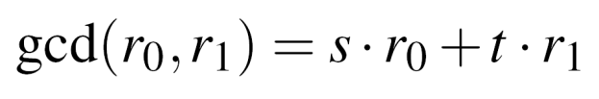
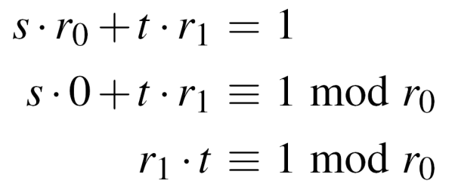
Extended Euclidean Algorithm 1/4
Extend the Euclidean algorithm（EEA）to find modular inverse of r₁ mod r₀
EEA computes s,t, and the gcd :
Note that gcd (r_{0,} r₁) = 1 in order for the inverse to exist
Take the relation mod r₀ :
→ Compare with the definition of modular inverse: t is the inverse of r₁ mod r₀
Recursive formulae to calculate s and t in each step
→“magic table” for r, s, t and a quotient q to derive the inverse with pen and paper
(cf. Section 6.3.2 in Understanding Cryptography)

Slide 23
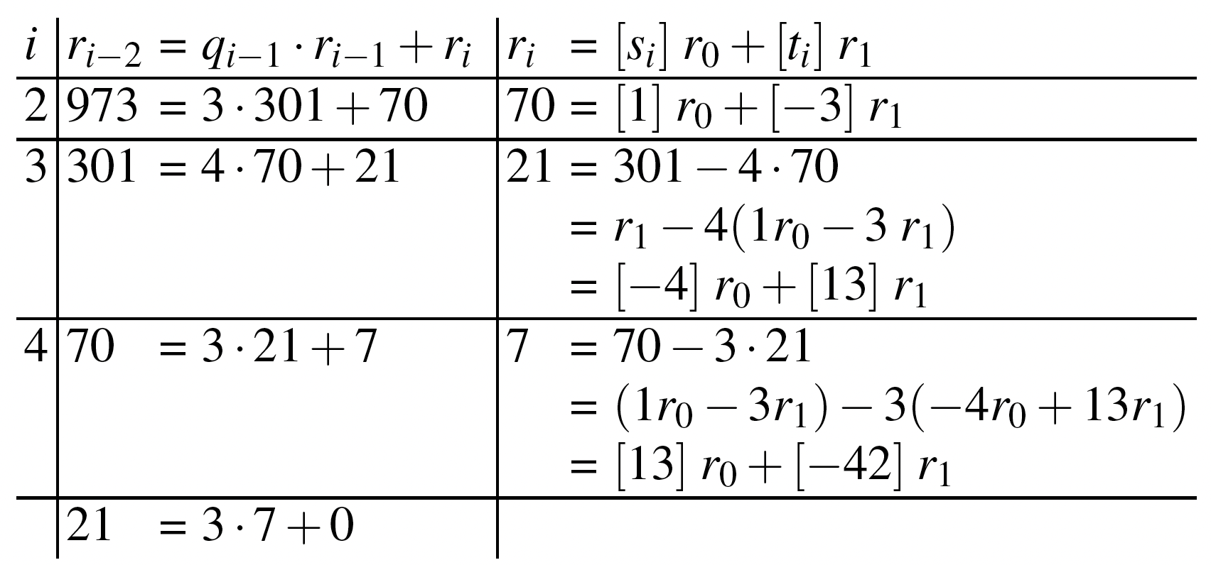
Extended Euclidean Algorithm 2/4
For r₀ = 973 and r₁ = 301
On the left, we compute the standard Euclidean algorithm.
On the right-hand side we compute the coefficients

Slide 24
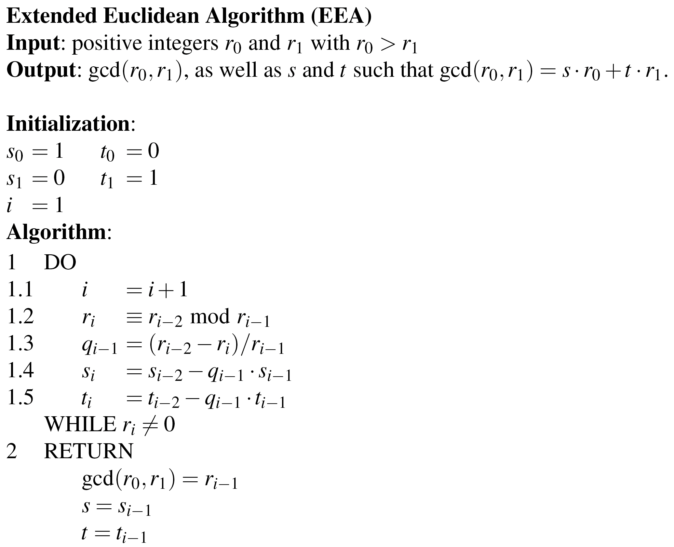
Extended Euclidean Algorithm 3/4

Slide 25
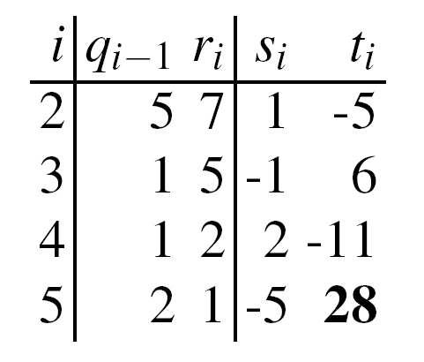

Extended Euclidean Algorithm 4/4
Example:
Calculate the modular Inverse of 12 mod 67:
From magic table follows
Hence 28 is the inverse of 12 mod 67.
Check:
For the full Extended Euclidean Algorithm see Chapter 6 in Understanding Cryptography.
✓

Slide 26
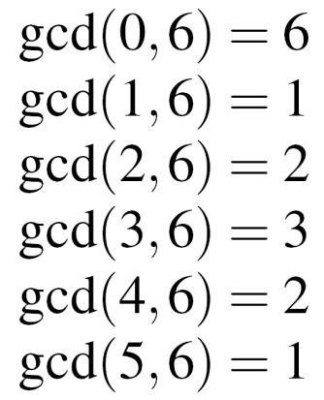
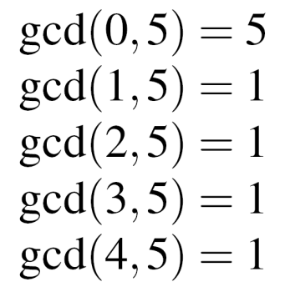
Euler‘s Phi Function 1/2
New problem, important for public-key systems, e.g., RSA: Given the set of the m integers {0, 1, 2, …, m -1}, How many numbers in the set are relatively prime to m ?
Answer: Euler‘s Phi function Φ(m)
Example for the sets {0,1,2,3,4,5} (m=6), and {0,1,2,3,4} (m=5)
→ 1 and 5 relatively prime to m=6, → Φ(5) = 4 hence Φ(6) = 2
Testing one gcd per number in the set is extremely slow for large m.

Slide 27
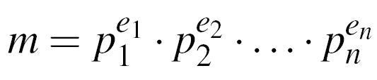
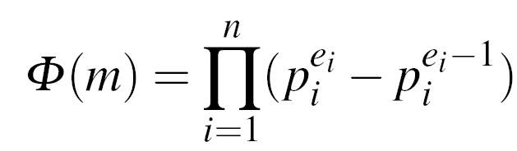
Euler‘s Phi Function 2/2
If canonical factorization of m known: (where p_{i} primes and e_{i} positive integers)
then calculate Phi according to the relation
Phi especially easy for e_{i} = 1, e.g., m = p . q → Φ(m) = (p-1) . (q-1)
Example m = 899 = 29 . 31: Φ(899) = (29-1) . (31-1) = 28 . 30 = 840
Note: Finding Φ(m) is computationally easy if factorization of m is known (otherwise the calculation of Φ(m) becomes computationally infeasible for large numbers)

Slide 28
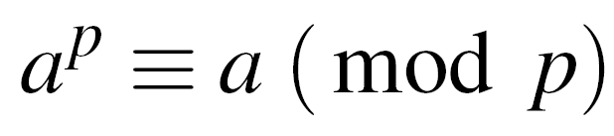
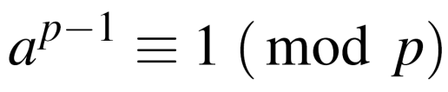

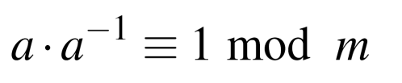
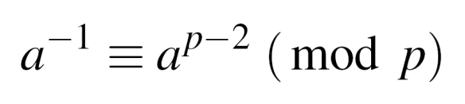


Fermat‘s Little Theorem
Given a prime p and an integer a:
Can be rewritten as
Use: Find modular inverse, if p is prime. Rewrite to
Comparing with definition of the modular inverse
→ is the modular inverse modulo a prime p
Example: a = 2, p = 7
Fermat‘s Little Theorem works only modulo a prime p
✓

Slide 29
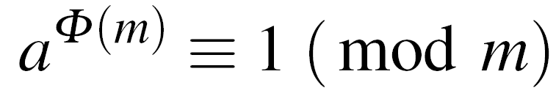

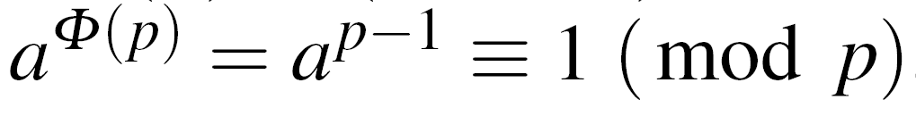
Euler‘s Theorem
Generalization of Fermat‘s little theorem to any integer modulus
Given two relatively prime integers a and m :
Example: m=12, a=5
1. Calculate Euler‘s Phi Function
2. Verify Euler‘s Theorem
Fermat‘s little theorem = special case of Euler‘s Theorem
for a prime p:
→ Fermat:

Slide 30
Lessons Learned
Public-key algorithms have capabilities that symmetric ciphers don’t have, in particular digital signature and key establishment functions.
Public-key algorithms are computationally intensive (a nice way of saying that they are slow), and hence are poorly suited for bulk data encryption.
Only three families of public-key schemes are widely used. This is considerably fewer than in the case of symmetric algorithms.
The extended Euclidean algorithm allows us to compute modular inverses quickly, which is important for almost all public-key schemes.
Euler’s phi function gives us the number of elements smaller than an integer n that are relatively prime to n. This is important for the RSA crypto scheme.

